Slide 1
Chapter-3
Adjusting The Accounts

Slide 2

Explain the accrual basis of accounting and the reasons for adjusting entries.
Accountants divide the economic life of a business into artificial time periods (Time Period Assumption).
. . . . .
Jan.
Feb.
Mar.
Apr.
Dec.
Generally a
  month,
  quarter, or
  year.
Alternative Terminology
The time period assumption
is also called the
periodicity assumption.

Slide 3
Interim Period, Fiscal and Calendar Years
Monthly and quarterly time periods are called interim periods.
Most large companies must prepare both quarterly and annual financial statements.
Fiscal Year = Accounting time period that is one year in length.
Calendar Year = January 1 to December 31.

Slide 4
Accrual- versus Cash-Basis Accounting
Accrual-Basis Accounting
  Transactions recorded in the periods in which the events occur.
  Companies recognize revenues when they perform services (rather than when they receive cash).
  Expenses are recognized when incurred (rather than when paid).
  In accordance with generally accepted accounting principles (GAAP).

Slide 5
Accrual- versus Cash-Basis Accounting
Cash-Basis Accounting
  Revenues recognized when cash is received.
  Expenses recognized when cash is paid.
  Cash-basis accounting is not in accordance with generally accepted accounting principles (GAAP).

Slide 6
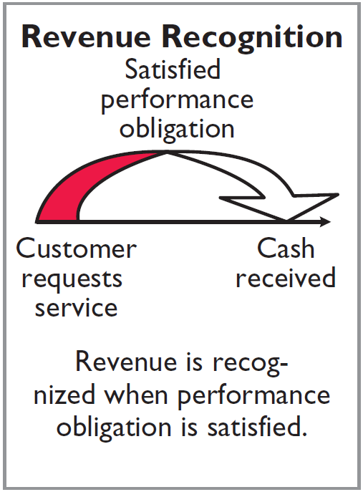
Recognizing Revenues and Expenses
REVENUE RECOGNITION PRINCIPLE
Recognize revenue in the accounting period in which the performance obligation is satisfied.

Slide 7
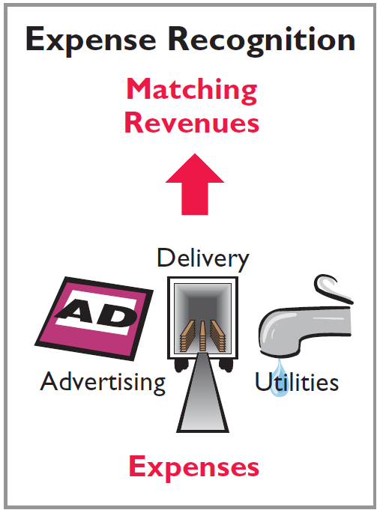

Recognizing Revenues and Expenses
EXPENSE RECOGNITION PRINCIPLE
Match expenses with revenues in the period when the company makes efforts that generate those revenues.
“Let the expenses follow the revenues.”

Slide 8
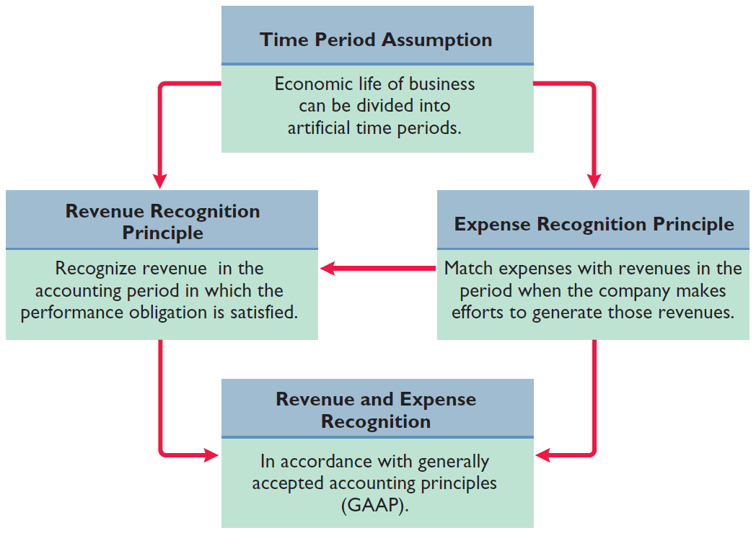
Illustration 3-1
GAAP relationships in revenue and expense recognition

Slide 9
The Need for Adjusting Entries
Adjusting Entries
  Ensure that the revenue recognition and expense recognition principles are followed.
  Necessary because the trial balance may not contain up-to-date and complete data.
  Required every time a company prepares financial statements.
  Will include one income statement account and one balance sheet account.

Slide 10
Types of Adjusting Entries
Illustration 3-2
Categories of adjusting entries
Deferrals
Accruals
1. Prepaid Expenses. Expenses paid in cash before they are used or consumed.
1. Accrued Revenues. Revenues for services performed but not yet received in cash or recorded.
2. Unearned Revenues.
Cash received before services are performed.
2. Accrued Expenses. Expenses incurred but not yet paid in cash or recorded.

Slide 11
Prepare adjusting entries for deferrals.
Deferrals are expenses or revenues that are recognized at a date later than the point when cash was originally exchanged. There are two types:
  Prepaid expenses
  Unearned revenues

Slide 12
Depreciation
  Buildings, equipment, and motor vehicles (assets that provide service for many years) are recorded as assets, rather than an expense, on the date acquired.
  Depreciation is the process of allocating the cost of an asset to expense over its useful life.
  Depreciation does not attempt to report the actual change in the value of the asset.
    Allocation concept, not a valuation concept.

Slide 13
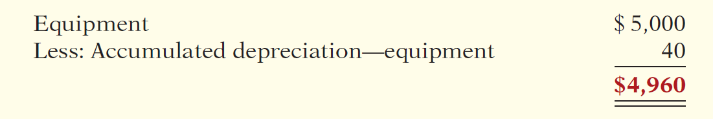
Depreciation
STATEMENT PRESENTATION
  Accumulated Depreciation is a contra asset account (credit).
  Offsets related asset account on the balance sheet.
  Book value is the difference between the cost of any depreciable asset and its accumulated depreciation.
Illustration 3-8

Slide 14
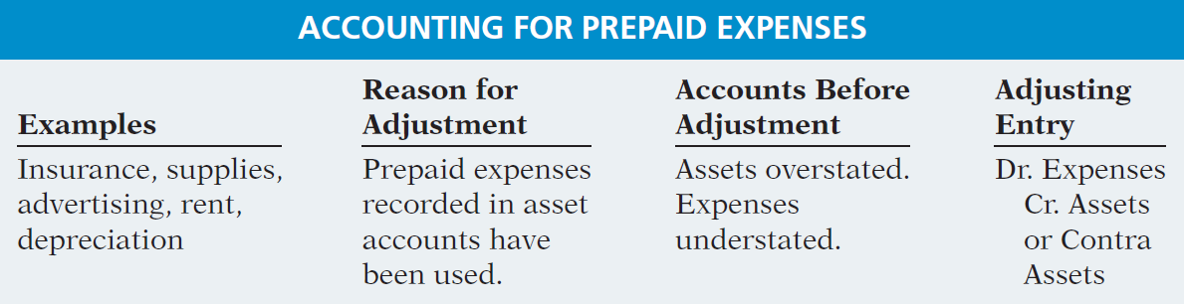
Prepaid Expenses
Summary of the accounting for prepaid expenses.
Illustration 3-9
Accounting for prepaid expenses

Slide 15
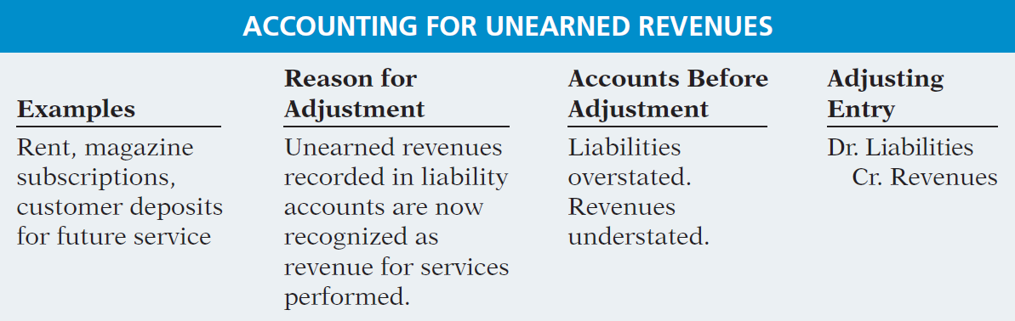
Unearned Revenues
Summary of the accounting for unearned revenues.
Illustration 3-12

Slide 16
Adjusting Entries for Deferrals
The ledger of Hammond Company, on March 31, 2017, includes these selected accounts before adjusting entries are prepared.
Debit Credit
Prepaid Insurance $ 3,600
Supplies 2,800
Equipment 25,000
Accumulated Depreciation—Equipment $5,000
Unearned Service Revenue 9,200
An analysis of the accounts shows the following.
Insurance expires at the rate of $100 per month.
Supplies on hand total $800.
The equipment depreciates $200 a month.
During March, services were performed for one-half of the unearned service revenue.
Prepare the adjusting entries for the month of March.

Slide 17
Prepare adjusting entries for accruals.
Accruals are made to record
  Revenues for services performed but not yet recorded at the statement date.
  Expenses incurred but not yet paid or recorded at the statement date.

Slide 18
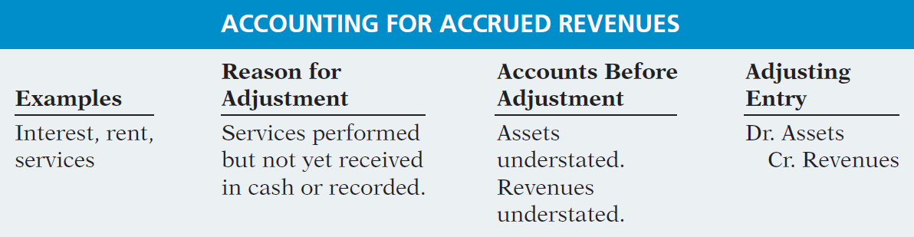
Accrued Revenues
Summary of the accounting for accrued revenues.
Illustration 3-15

Slide 19
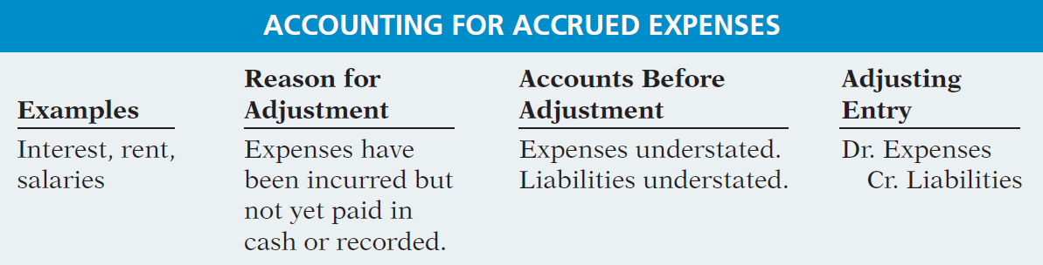
Accrued Expenses
Summary of the accounting for accrued expenses.
Illustration 3-21

Slide 20
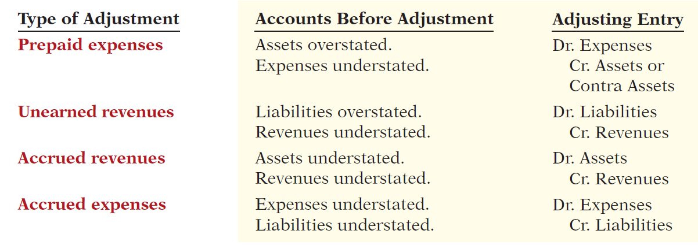
Summary of Basic Relationships
Illustration 3-22

Slide 21
Adjusting Entries for Accruals
Micro Computer Services began operations on August 1, 2017. At the end of August 2017, management prepares monthly financial statements. The following information relates to August.
At August 31, the company owed its employees $800 in salaries and wages that will be paid on September 1.
On August 1, the company borrowed $30,000 from a local bank on a 15-year mortgage. The annual interest rate is 10%.
Revenue for services performed but unrecorded for August totaled $1,100.
Prepare the adjusting entries needed at August 31, 2017.

Slide 22
Describe the nature and purpose of an adjusted trial balance.
Adjusted Trial Balance
  Prepared after all adjusting entries are journalized and posted.
  Purpose is to prove the equality of debit balances and credit balances in the ledger.
  Is the primary basis for the preparation of financial statements.

Slide 23
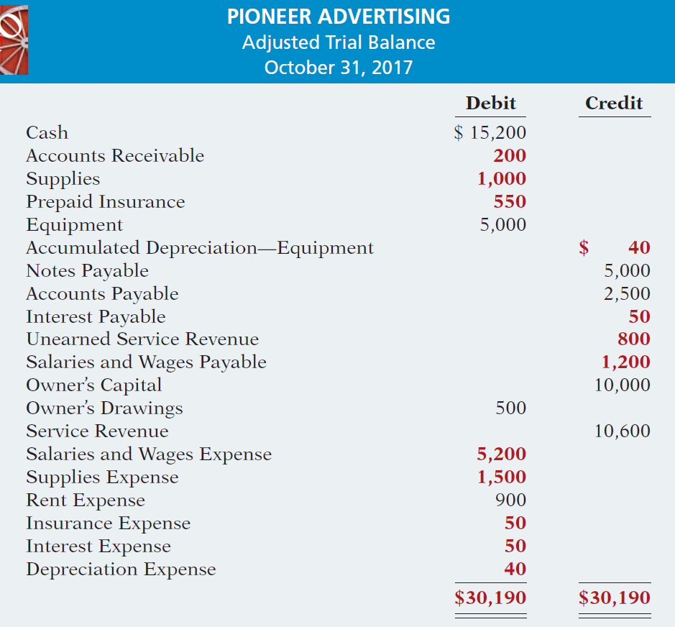

Illustration 3-25

Slide 24
Preparing Financial Statements
Financial Statements are prepared directly from the Adjusted Trial Balance.
Income Statement
Owner’s Equity Statement
Balance Sheet

Slide 25
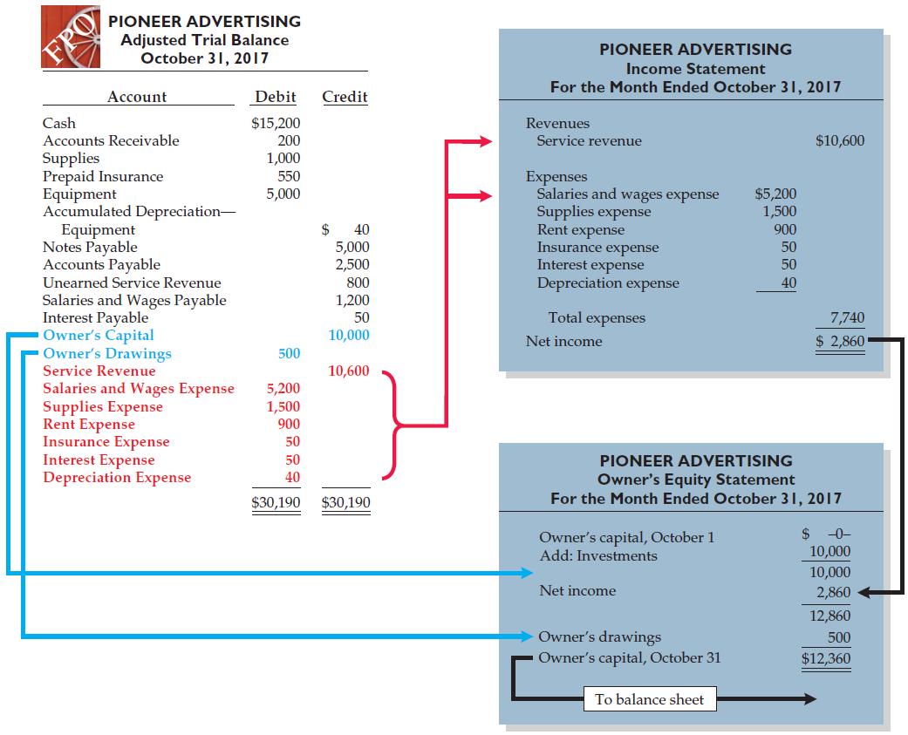
Illustration 3-26
Preparation of the income statement and owner’s equity statement from the adjusted trial balance

Slide 26
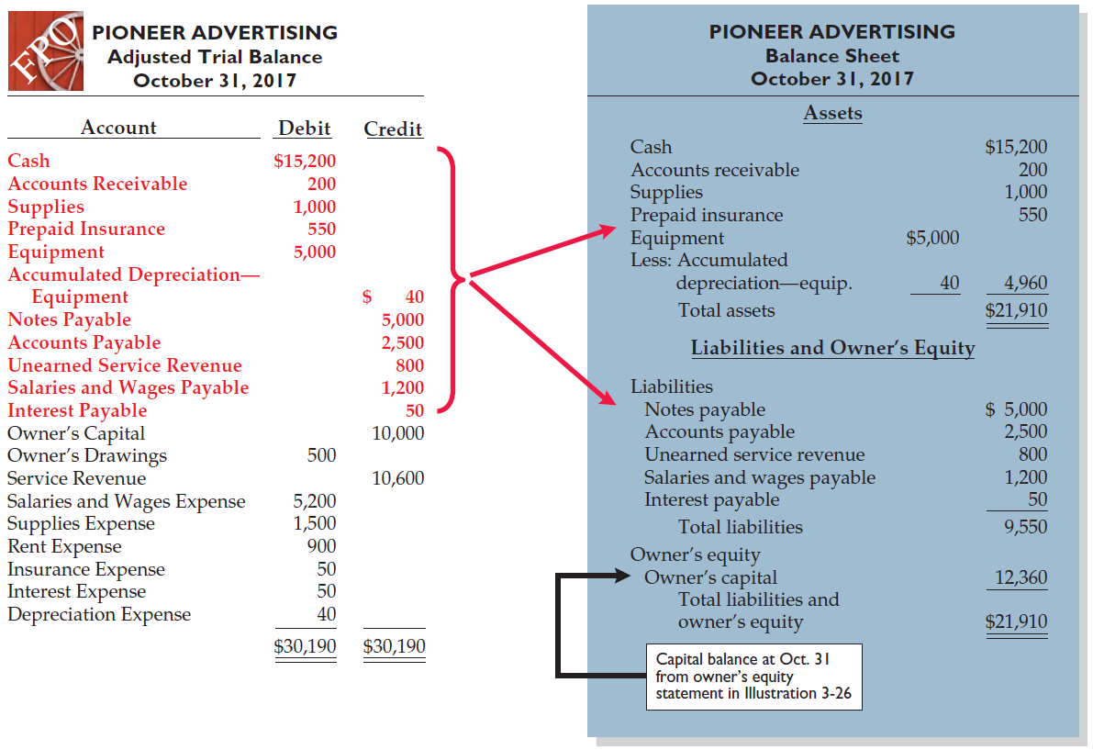
Illustration 3-27
Preparation of the balance sheet from the adjusted trial balance

Slide 27
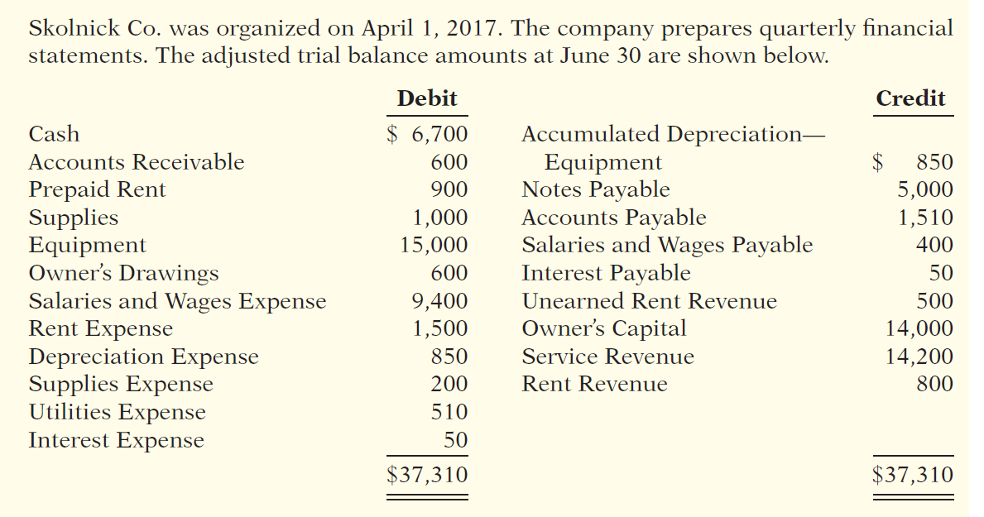
Trial Balance
(a) Determine the net income for the quarter April 1 to June 30.
(b) Determine the total assets and total liabilities at June 30, 2017, for Skolnick Co.
(c) Determine the amount of owner’s capital at June 30, 2017.

Slide 28
Problem- 1
Terry Thomas opens the Green Thumb Lawn Care Company on April 1. At April 30, the trial balance shows the following balances for selected accounts.
Prepaid Insurance $ 3,600
Equipment 28,000
Notes Payable 20,000
Unearned Service Revenue 4,200
Service Revenue 1,800
Analysis reveals the following additional data.
1.Prepaid insurance is the cost of a 2-year insurance policy, effective April 1.
2.Depreciation on the equipment is $500 per month.
3.The note payable is dated April 1. It is a 6-month, 12% note.
4.Seven customers paid for the company’s 6 months’ lawn service package of $600 beginning in April. The company performed services for these customers in April
5. Lawn services provided other customers but not recorded at April 30 totaled $1,500.
Instructions: Prepare the adjusting entries for the month of April.

Slide 29
Problem-2
Melton River Resort opened for business on June 1 with eight air-conditioned units. Its trial balance before adjustment on August 31 is as follows.
Debit Credit
Cash $19,600
Supplies 3,300
Prepaid Insurance 6,000
Land 25,000
Buildings 125,000
Equipment 26,000
Accounts Payable $ 6,500
Unearned Rent Revenue 7,400
Mortgage Payable 80,000
Owner’s Capital 100,000
Owner’s Drawings 5,000
Rent Revenue 80,000
Maintenance and Repairs Expense 3,600

Slide 30
Problem-2
Salaries and Wages Expense 51,000
Utilities Expense 9,400
Total $273,900 $273,900
Other data:
1. Insurance expires at the rate of $300 per month.
2. A count on August 31 shows $800 of supplies on hand.
3. Annual depreciation is $6,000 on buildings and $2,400 on equipment.
4. Unearned rent revenue of $4,800 was earned prior to August 31.
5. Salaries of $400 were unpaid at August 31.
6. Rentals of $4,000 were due from tenants at August 31. (Use Accounts Receivable.)
7.The mortgage interest rate is 9% per year. (The mortgage was taken out on August 1.)
Instructions
(a)Journalize the adjusting entries on August 31 for the 3-month period June 1–August 31.
(b) Prepare the adjusted trial balance

